Slide 1
HR Analytics Presentation :
Unlocking Insights for Strategic Decision-Making

Slide 2
Index :
◊ Introduction
◊ KPI’s Observations and Solutions
◊ Overview of all the Dashboards
◊ Challenges Faced

Slide 3
Group No - 4
Name of Members :
Fardeen Shaikh
Samadhan Adabal
Tanush Chilveri
Suraj Tayade
Kalpesh Bhosale
Pratik Girolkar

Slide 4
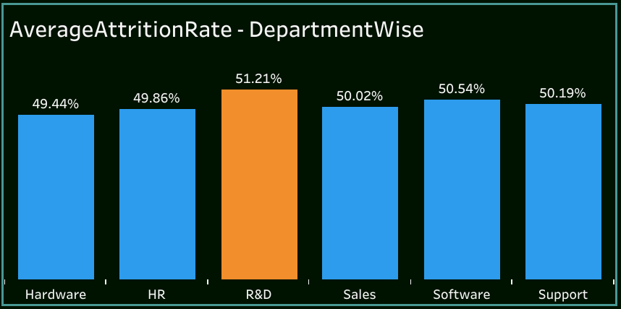
1st Kpi
This Kpi Shows the Average Attrition Rate Department Wise.
◊ Observation ◊
● Research and Development Department is Experiencing a High Attrition Rate i:e (51.21%).
◊ Solution ◊
● Conduct regular surveys to gather feedback from R&D employees.
● Implement changes based on the feedback received.

Slide 5
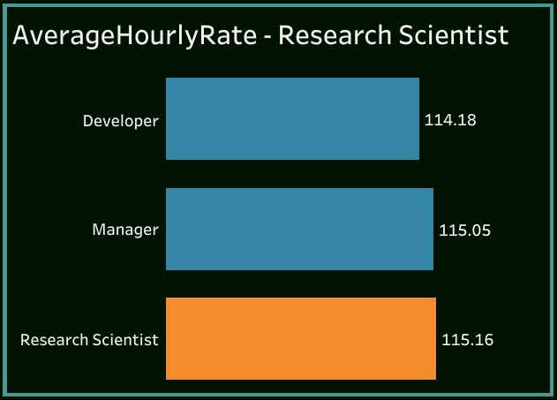
2nd KPI
This KPI shows the Average Hourly Rate for the Research Scientist.
◊ Observation ◊
● The Average Hourly Rate of the Research Scientist i:e(115.6) is comparatively High as Compared to the Other Job Roles .
◊ Suggestion ◊
● Ensure that the Hourly Rate for Research Scientist is Competitive and Aligns with the current Market Rate

Slide 6
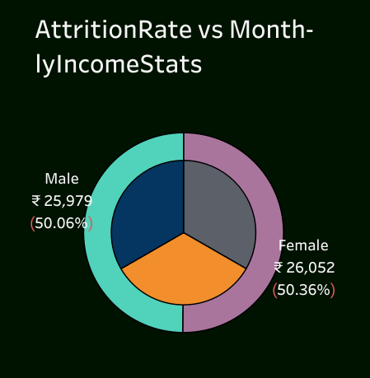
3rd KPI
This Kpi shows the Attrition Rate of Male and Female Employees Compared to their Monthly Incomes.
◊ Observation ◊
● The Attrition Rate for Female Employees(50.36%) is Higher Despite having a Higher Salary compared to the Male Employees(50.06%) .
◊ Solution ◊
● Ensure that the Female Employees have Equal access to Training and Career Development Opportunity

Slide 7
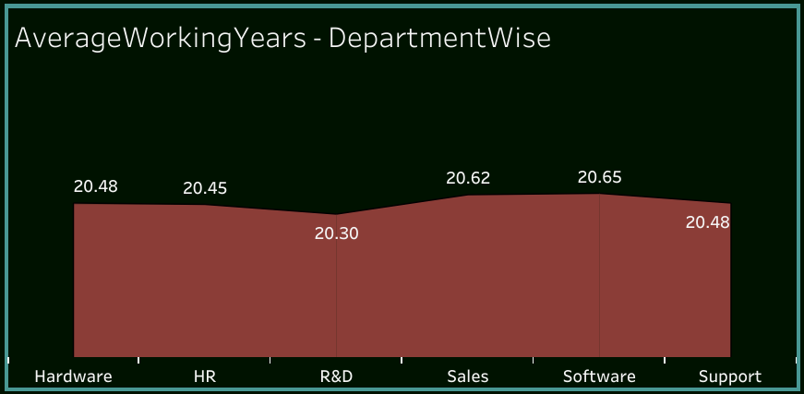
4th KPI
This Kpi shows the Average Working Years for all the Departments .
◊ Observation ◊
● R&D has the Lowest Working Years (20.30) compared to the other Departments .
◊ Suggestion ◊
● Implement Recognition and Reward Programs to Appreciate Long – Term Working Employees .

Slide 8
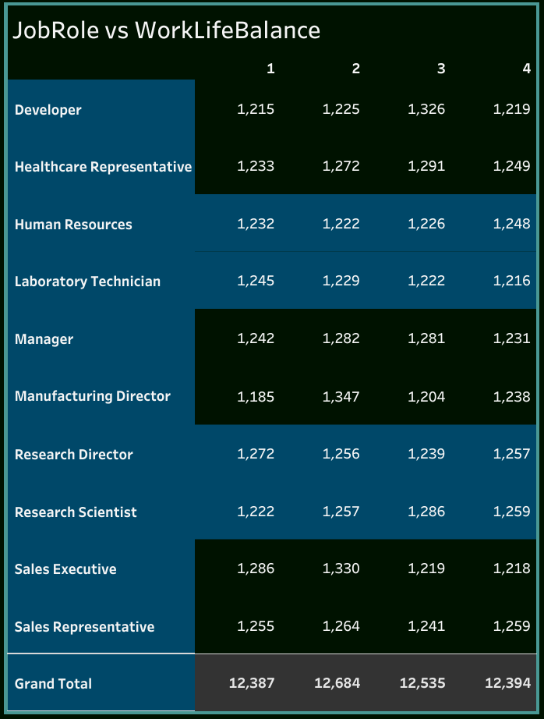
5th KPI
This Kpi shows Employee’s Review on Work Life Balance in accordance to the Job Roles .
◊ Observation ◊
● Role which received the Highest Number 1 rating(Most Satisfaction) – Sales Executive
● Role which received the Highest Number 5 rating(Least Satisfaction) – Research Scientist and Sales Representative.
◊ Solution◊
● Ensure that the Employees are Fairly Compensated
And have Great Career growth opportunities .

Slide 9
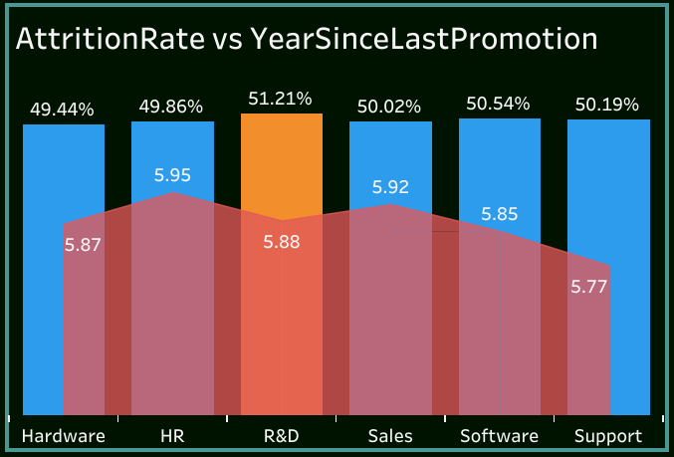
6th KPI
This Kpi shows the Attrition Rate of Employees and the Years since the Last Promotion .
◊ Observation ◊
● R&D Department has the Highest Attrition Rate followed by the Software Department .
◊ Solution ◊
● Assess the effectiveness of leadership within the R&D department.
● Analyze feedback on management styles and communication from employees.

Slide 10
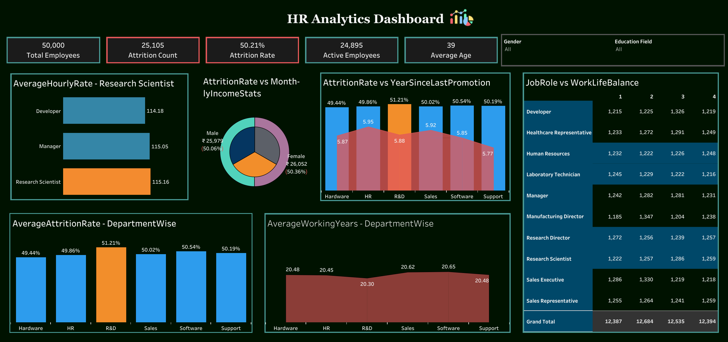
Tableau Dashboard

Slide 11
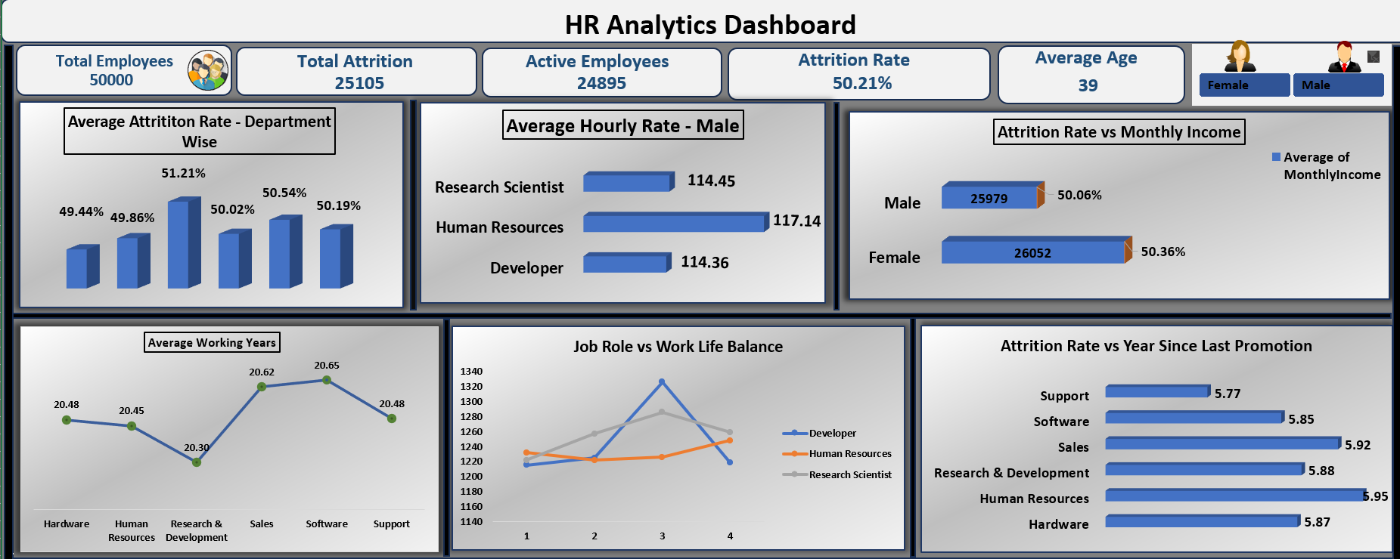
Excel Dashboard

Slide 12
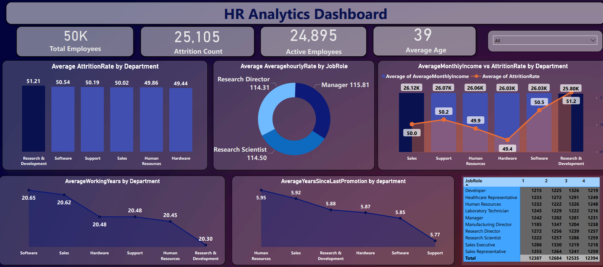
Power bi Dashboard

Slide 13
Problems and Challenges Faced :
◊ Determining the key factors affecting Attrition were a little complex.
◊ Translate findings into actionable insights for HR.
◊ Selecting the most relevant and meaningful metrics for the dashboard was a little challenging.

Slide 14
Thank You !!!

